Slide 1
AFFIRM Monthly Advisory Meeting
January 12, 2026
Adam Ducorsky, Wendy Crane, Denise Madigosky

Slide 2
AGENDA
Welcome 2026
AiPEX
Q1 2026 Roadmap Review
Forms & Signature Validation – Denise

Slide 3


Slide 4
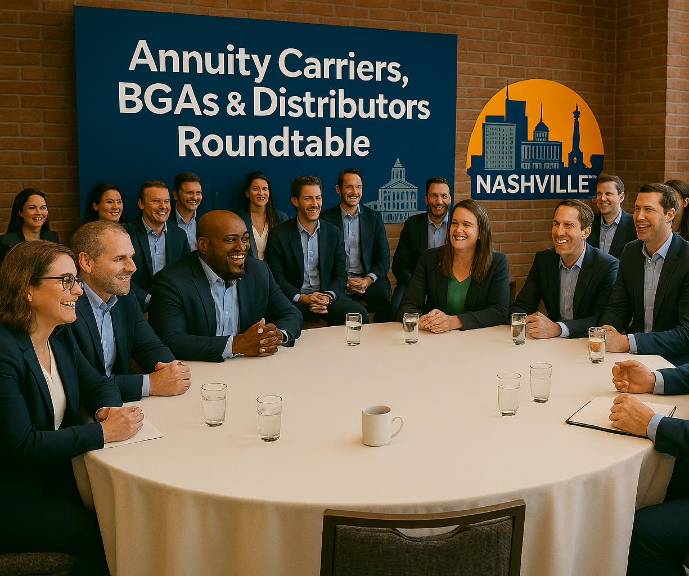
AFFIRM Roundtables
Day 1
  3 Separate Roundtables
    Distributors
    Carriers
    BGAs
Day 2
  Bring Everyone Together –
  A Large Roundtable

Slide 5
Roundtables
A Call to Action!
The Prework
Send us the following:
  NIGO Rates
  Top NIGO Reasons
  Top Reasons for Agent Calls
  Top Pain Points
Please include metrics, quantify with numbers and percentages
The Why
Able to review data for both carriers and distributors before roundtables to:
  Identify Themes and Trends
  Provide Value
  Drive Discussion Points
When: NOW through February

Slide 6
AFFIRM Roadmap
PHASE X
NEAR
NEXT
FUTURE
Winter Release 4/10/26
TBD
Move to AWS
DTCC Changes
eSignature for AFFIRM for Life
Forms & Signature Validation: Building the Foundation
Forms & Signature Validation
Headless APIs
DTCC Document Processing API
Production: 3/20/26

Slide 7
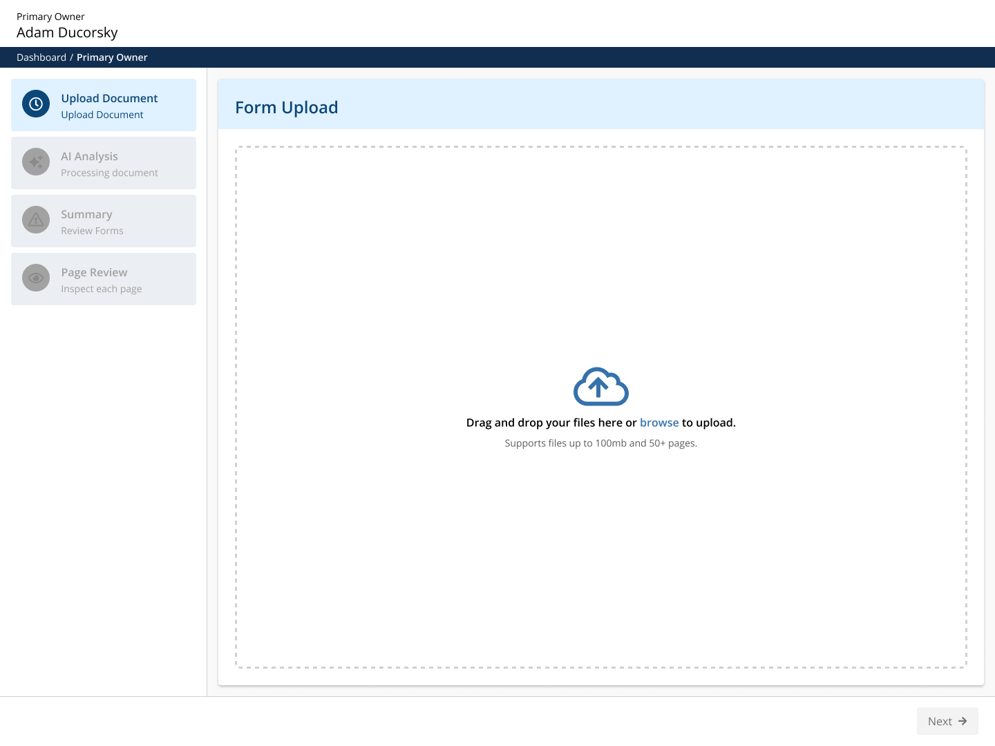
Forms & Signature Validation

Slide 8
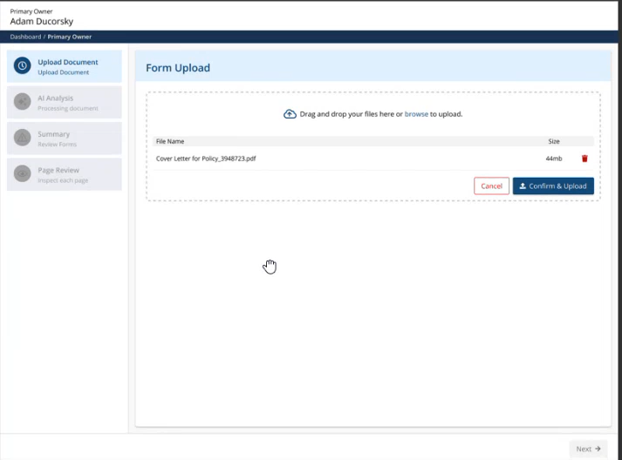

Slide 9
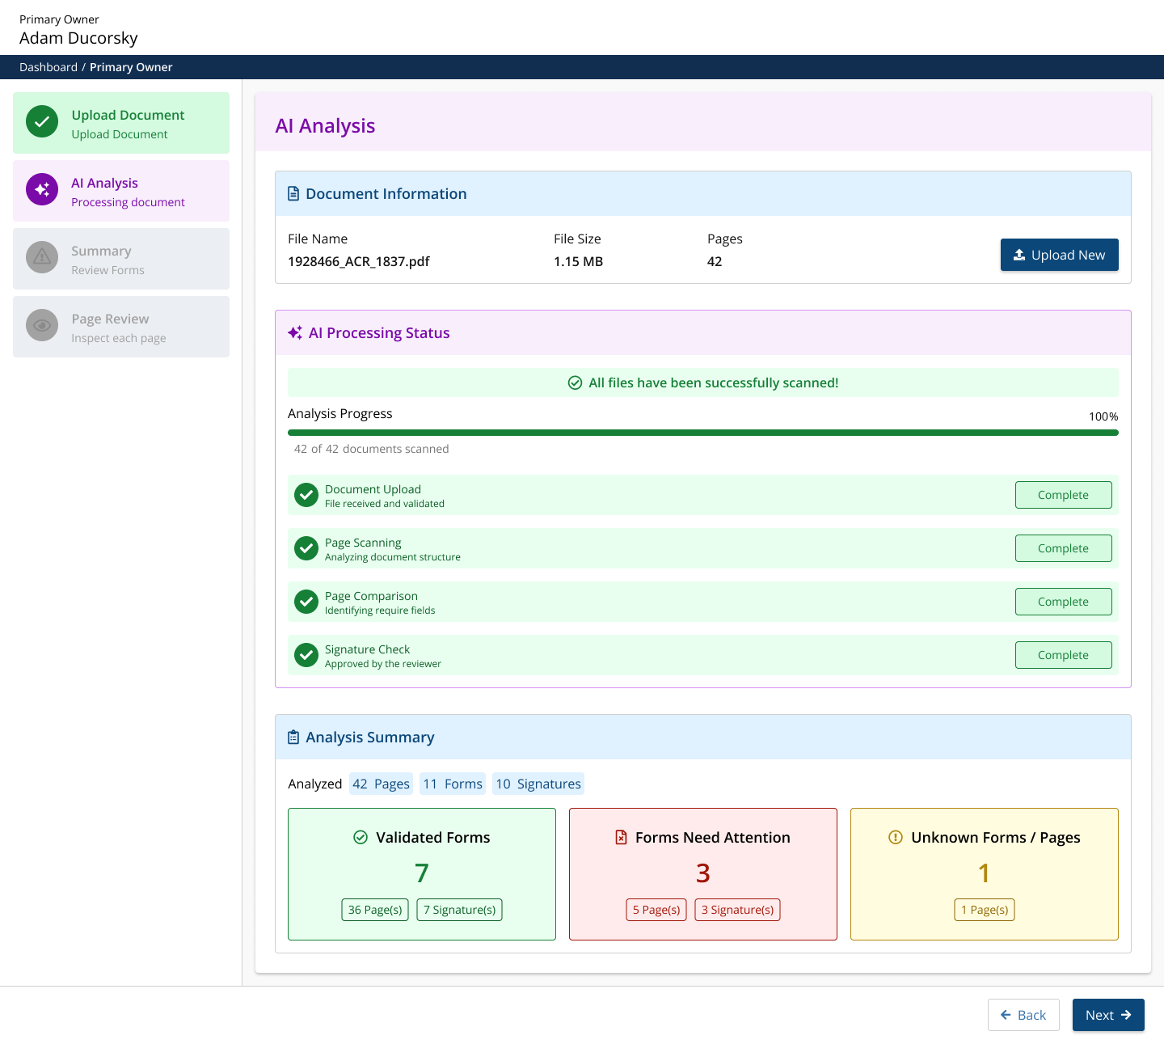

Slide 10
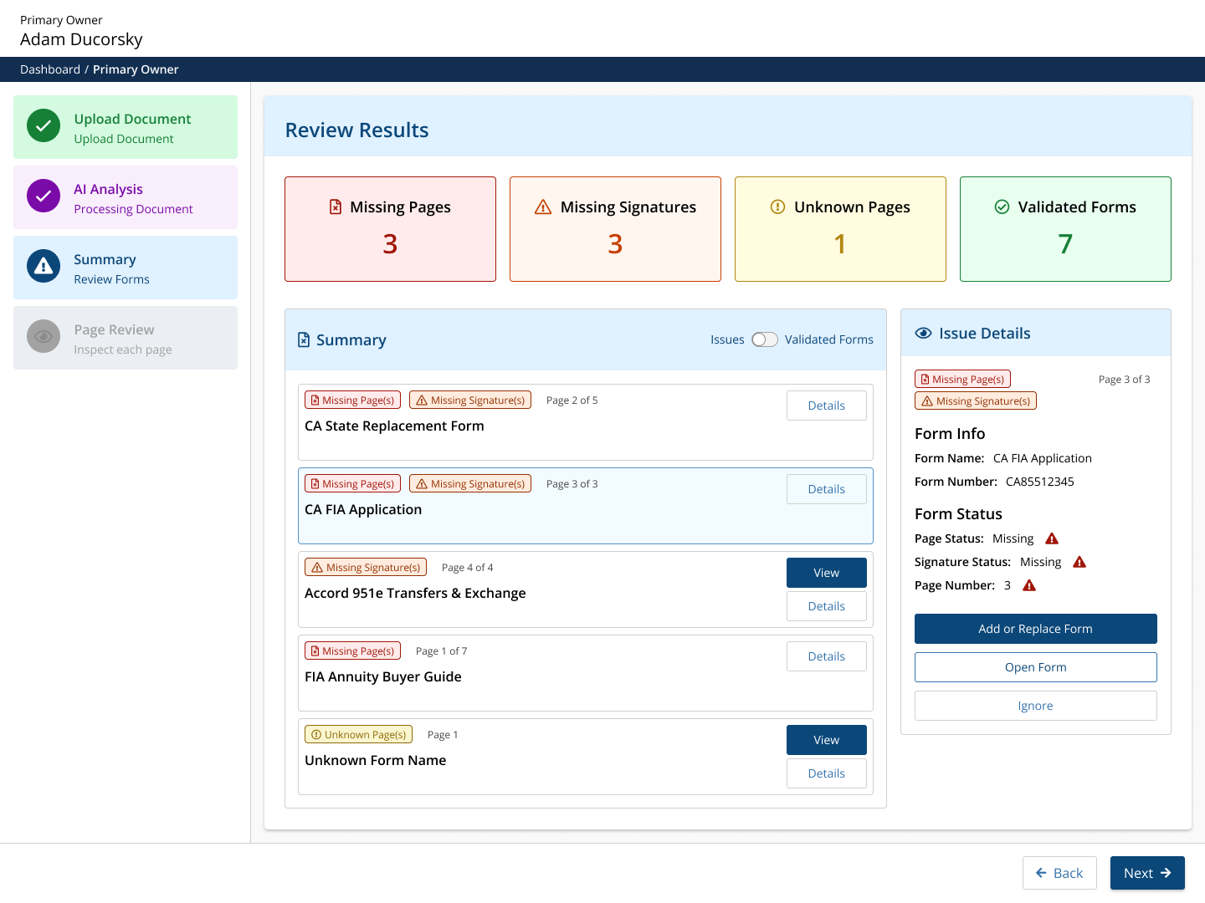

Slide 11
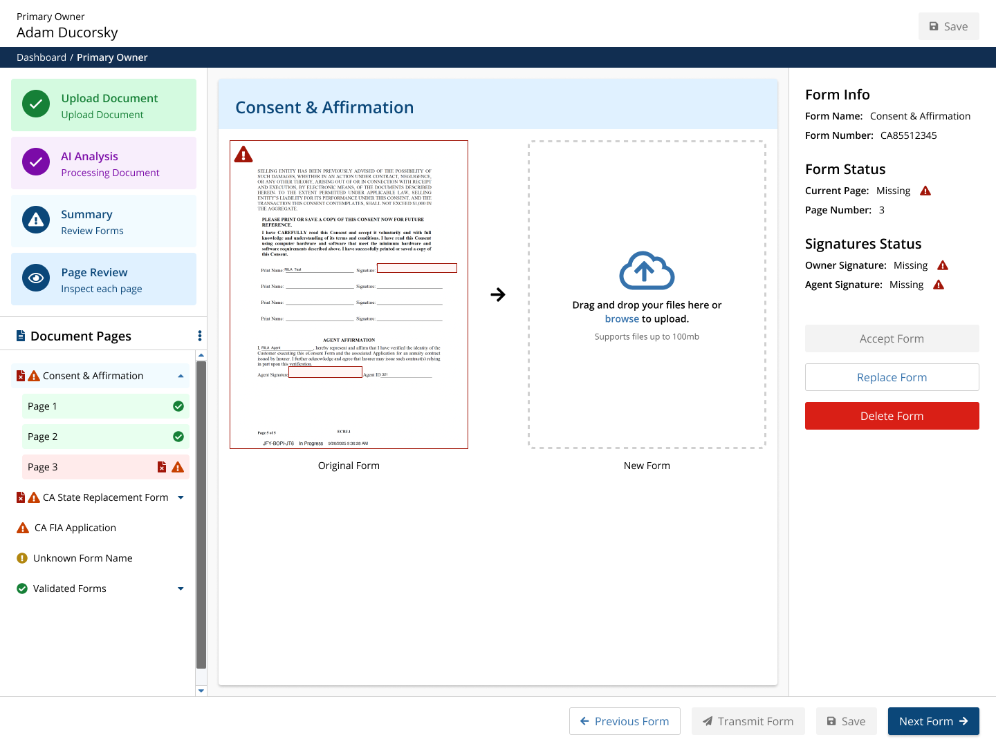

Slide 12
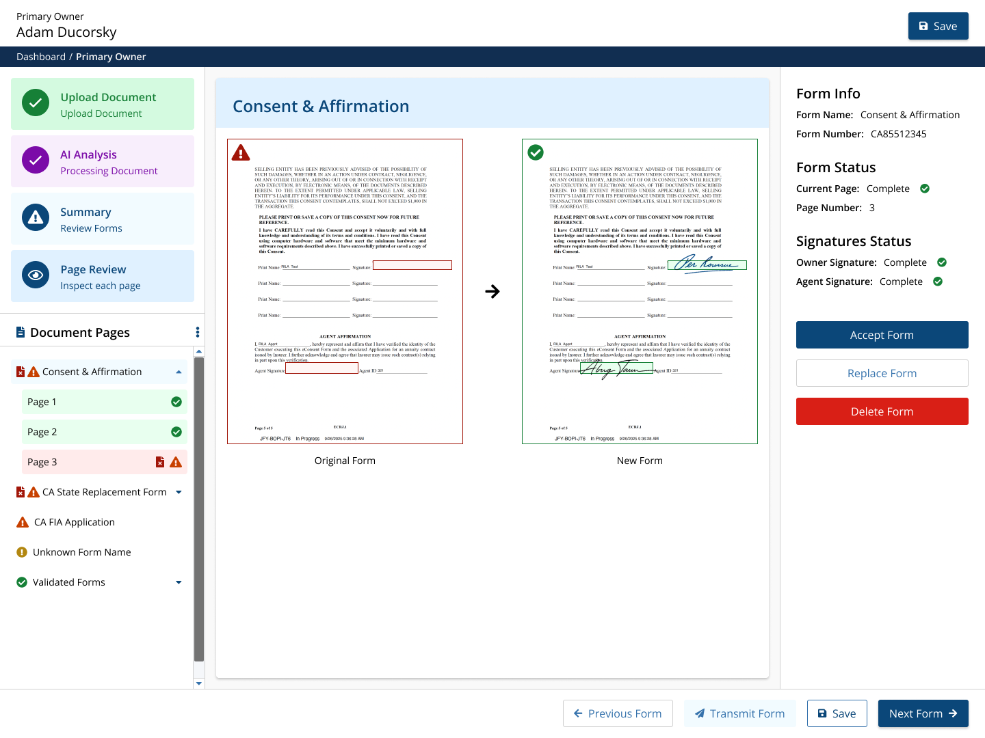

Slide 13
